Slide 1
Welcome back! Day 2
Let’s get to know one another.
While you wait for everybody to enter the class, use your phone to go to https://whiteboard.fi/h3f6y and start writing the numbers
EN ESPAÑOL from 1 to 20. You can only handwrite your numbers.
If you need help with the numbers, open the PowerPoint from yesterday’s lesson in the resources section on the left of the screen of our CTLS classroom.

Slide 2
From mindless to mindful

Slide 3
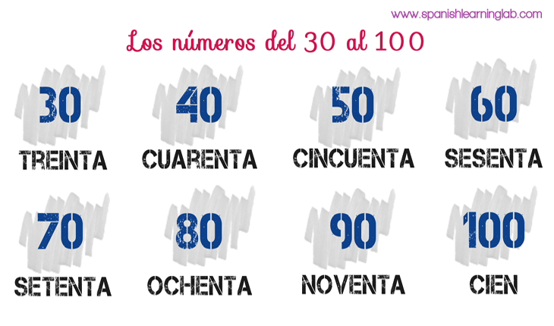
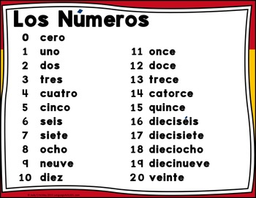
What did we learn yesterday? * You should already have your notes out, with paper and a pencil!
Los números!

Slide 4
Más números
200 doscientos
300 trescientos
400 cuatrocientos
500 quinientos
600 seiscientos
700 setecientos
800 ochocientos
900 novecientos
1000 mil

Slide 5
¡A practicar!
Mute your microphone (keep your camera on)and practice for two minutes saying the numbers from one to twenty. Then, record yourself on your phone and listen to your recording. Now, count by tens from thirty to one hundred and from 100 to 1000 (5 minutes)
You can pull out the PowerPoint from the lesson.

Slide 6
¡Vamos a jugar KAHOOT!

Slide 7
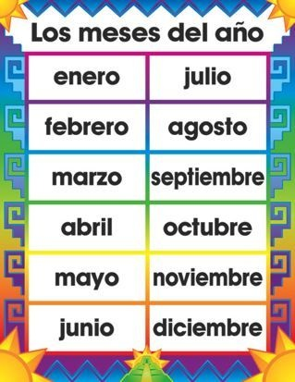

Slide 8
¡A practicar!
Practica los dias de la semana aquí:
https://www.quia.com/jw/476796.html?AP_rand=401455120
https://www.quia.com/rd/278655.html?AP_rand=1326825287
Practica los meses del año aquí:
https://www.quia.com/hm/857220.html
https://www.quia.com/rd/283977.html

Slide 9
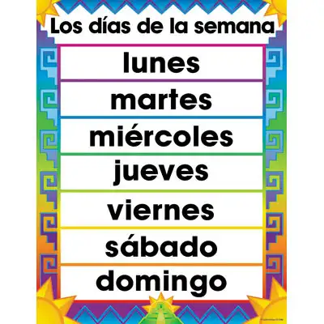

Slide 10
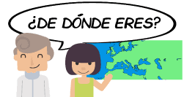
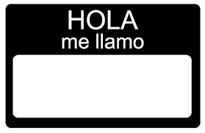
¿Qué más?

Slide 11
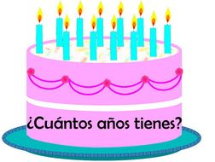
Más preguntas……

Slide 13
¡A hablar!
5 minutes. Practice with your group.
Take turns asking and answering all 4 questions.
Open the PowerPoint for today’s lesson in the resources folder.

Slide 14
Tarea:
Before Thursday, you should know all your numbers, days, and months and the four questions!
Let’s go back to FlipGrid!
Film your SPANISH introduction today!
Answer the 4 questions:
¿Cómo te llamas?
¿De dónde eres?
¿Cuándo es tu cumpleaños?
¿Cuántos años tienes?
Only submit one video, but practice as much as you want before submitting.

Slide 16
