Slide 1
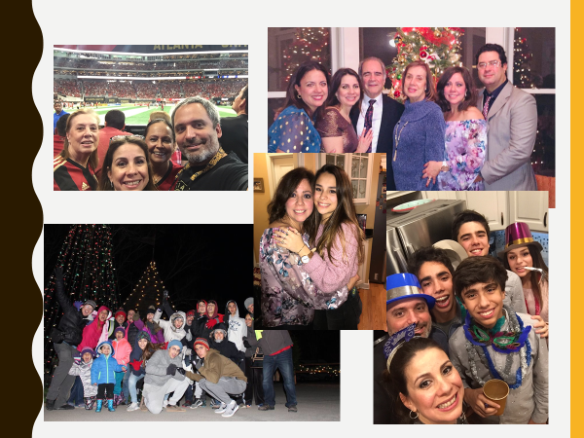
Open House
Sra. Mariela Pulido
Honors Spanish V-1st Block
Honors Spanish II- 2nd & 4th Block

Slide 2
¡ Bienvenidos!
My Contact Information
Room 2303
mariela.pulido@cobbk12.org
678-331-3961 ext. 2303 = voicemail
Remind
2nd & 4th Blocks (Honors Spanish 2)
-Text the message @79f8a to the number 81010.
1st Block (Honors Spanish 5)
-Text the message @cgg9g6 to the number 81010.

Slide 3
Curriculum Goals
Honors Spanish V
Goals include the 4 modes of the Subjunctive, Future/Conditional, Perfect tenses and all Commands forms. We will have two major projects, the Interview project and the Cultural project.
Honors Spanish II
Goals include proper use of Present Progressive, Reflexive verbs and Past tense.

Slide 4
Textbook and Resources
Honors Spanish V
Descubre 2-Students were not issued hard copy textbooks.
All students have been registered for the online textbooks.
Textbook access = VHL Central Website
Honors Spanish II
Descubre 1-Students were not issued hard copy textbooks

Slide 5
Daily Blog and Resources
You can find the day-to-day class activities on the blog =
Hillgrove Website Departments World Language Mariela Pulido Website
Under Blog, I will post the day-to-day activities including the PowerPoints I use in class
Under the resources pages, I will post documents, links
and more resources and practice for each unit.
https://srapulido.weebly.com/

Slide 6
Grading Categories for Honors Sp. 5
Listening…………………………………………….…….…...15%
Reading Comprehension……………….……..……..…15%
Speaking…………………………………….……………..……15%
Writing…………………………………………………..…......15%
Grammar……………….……………………………..….…….15%
Vocabulary……………………….……………………….…...15%
Comprehensive Final Exam……..........................10%
Total……………...................................................100%

Slide 7
Grading Categories for Honors Sp. 2
Formative Assessments - 15%
Formative assessments are comprised of in-class activities, VHL Central activities and homework.
All VHL Central Activities will count for a grade and will go into this category.
Summative Assessments - 30%
Essays, projects, quizzes related to grammar, writing, vocabulary, reading, speaking, listening and culture.
Formal Evaluations - 40%
Chapter/unit tests, major projects and presentations
Final Exam - 15%
There will be 4 parts to the final exam: listening, speaking, writing, and reading
Students are eligible to exempt all parts of the final exam by meeting all the requirements of the Final Exam Exception Policy. See Student Handbook.

Slide 8
How to Be Successful in Class
Have a positive attitude!
Keep an Organized Binder!
Practice Every Day!
Check the Blog Every Day!
Review Vocabulary and Grammar Every Day!
Complete ALL assignments! AND
Turn in ALL assignments!
Use Memorization Tools & Resources!

Slide 9
Class & School Policies
Be on time to class! 4th tardy = Saturday School = No Final Exam Exception!
I follow school policy on any infraction.
I will speak with the student first. I will contact parent.
Repetition of infraction will result in administrative referral =
Possible discipline action and no Final Exam Exception!
Cell phones and Earbuds are the biggest distraction for students!
Cell phone usage is only allowed on direction of the teacher!

Slide 10
One of the Biggest Concerns for Our Students-Vaping

Slide 11
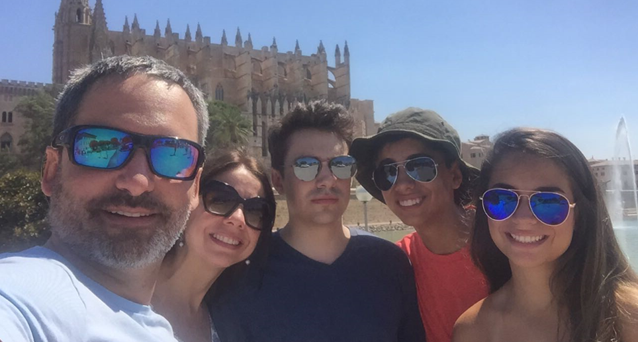
Questions?
If I am not able to hear and answer your question-
please email me – mariela.pulido@cobbk12.org
Thank you for attending tonight!
And, I will gladly take donations
Of hand sanitizer and Kleenexes!
¡Gracias!

